Slide 1

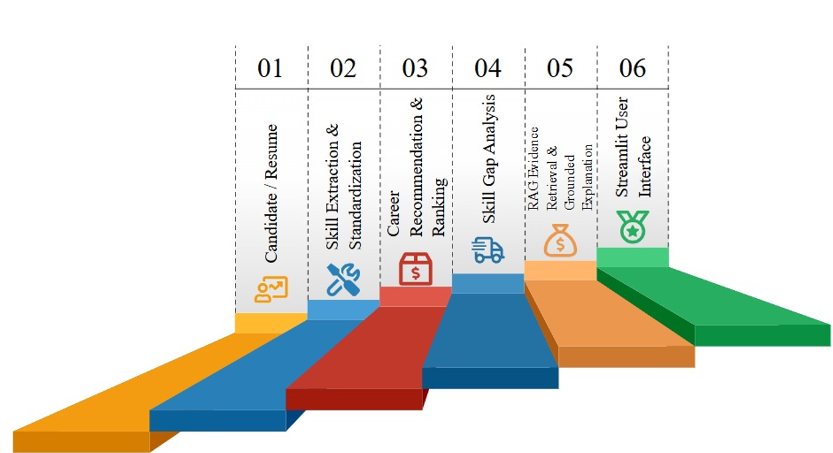
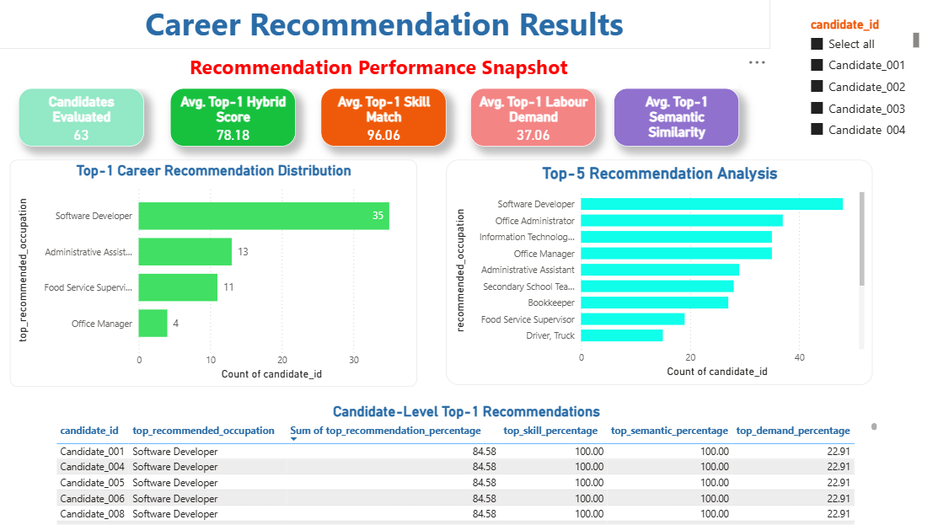
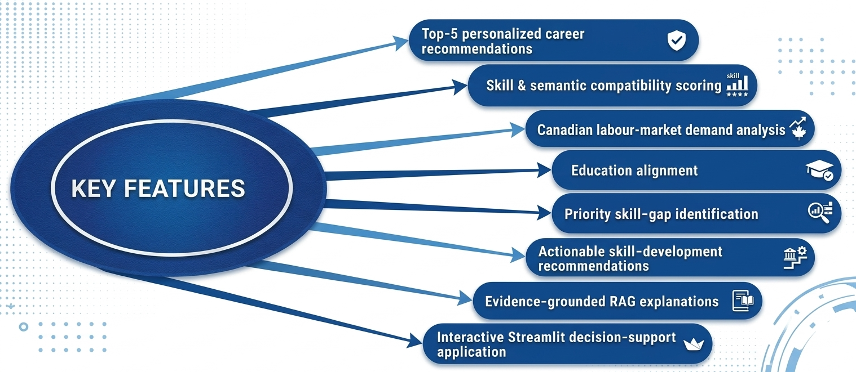
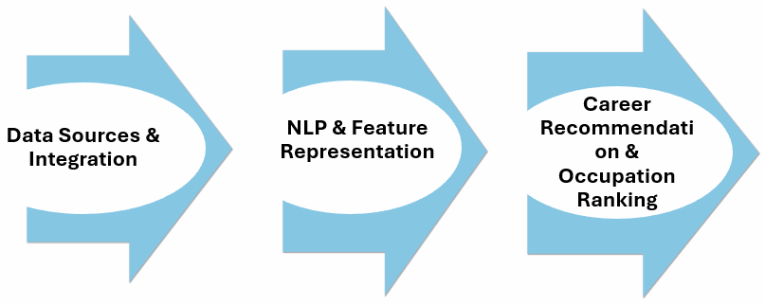
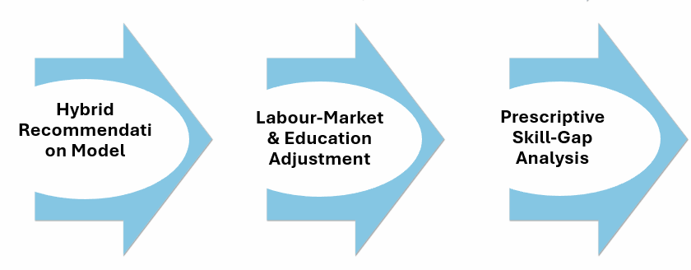
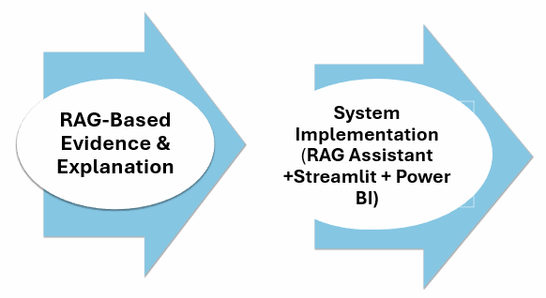
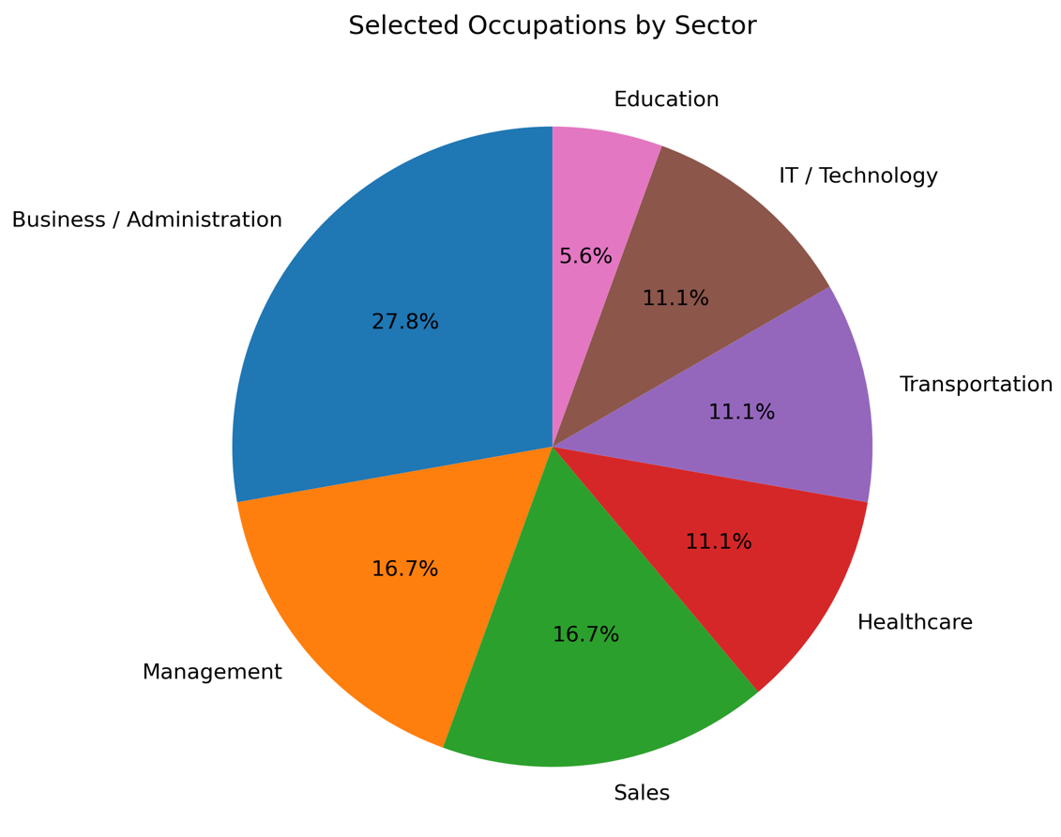
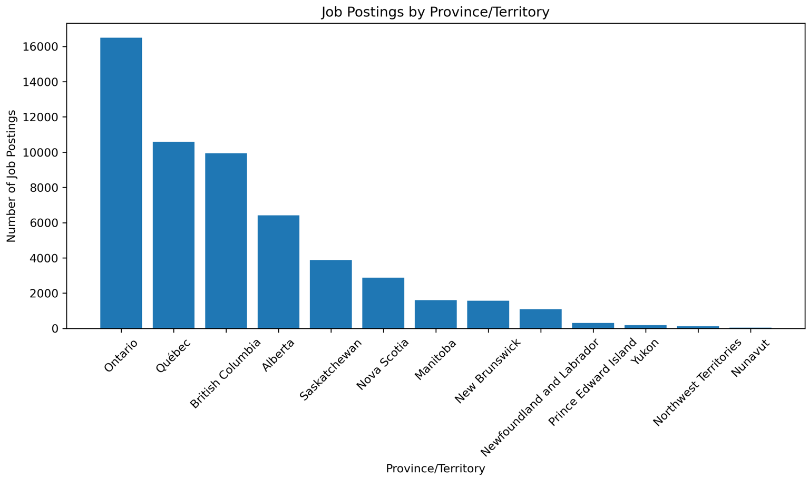
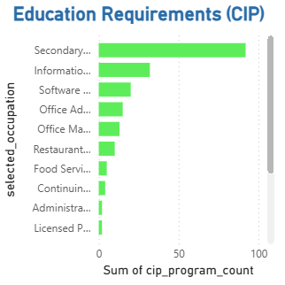
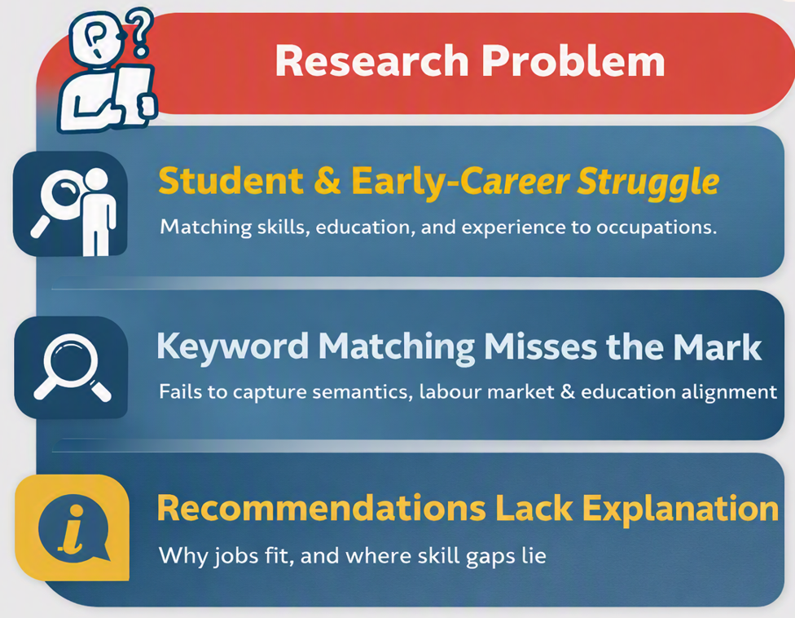
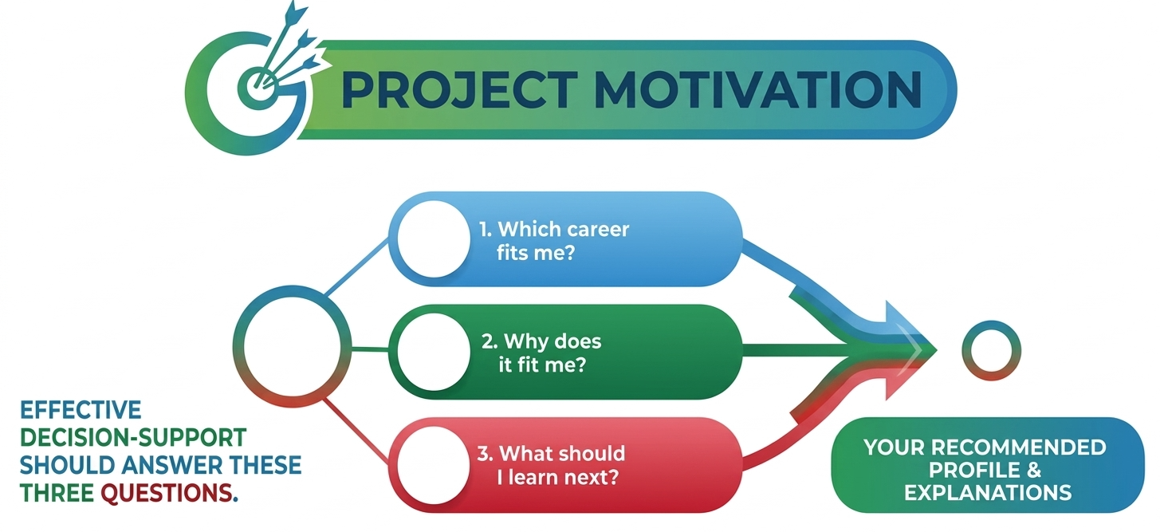
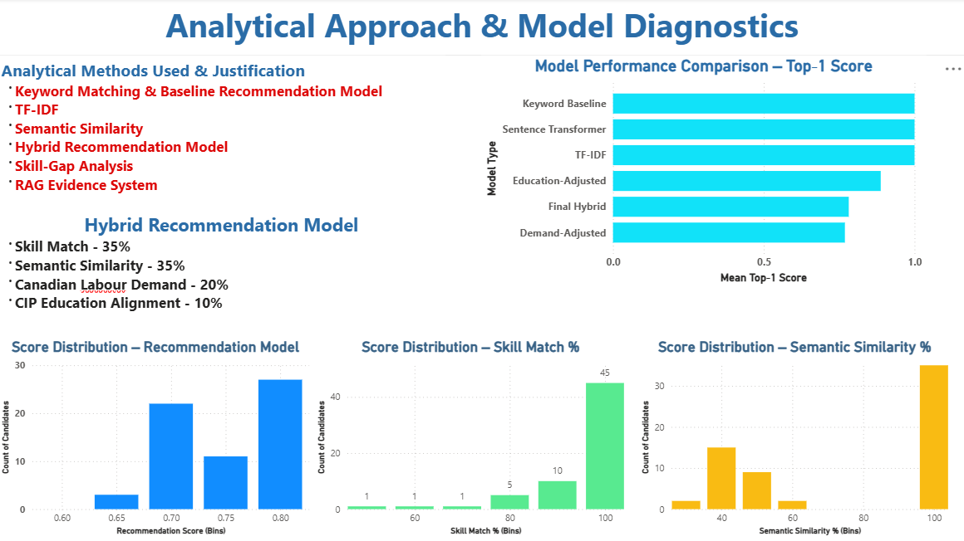
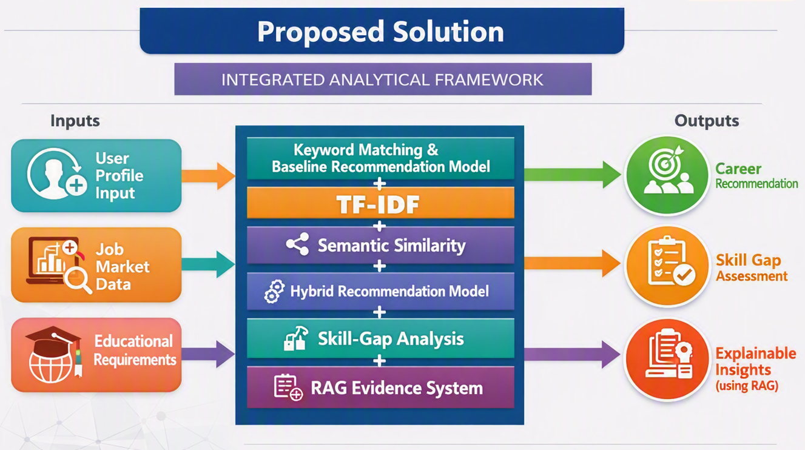
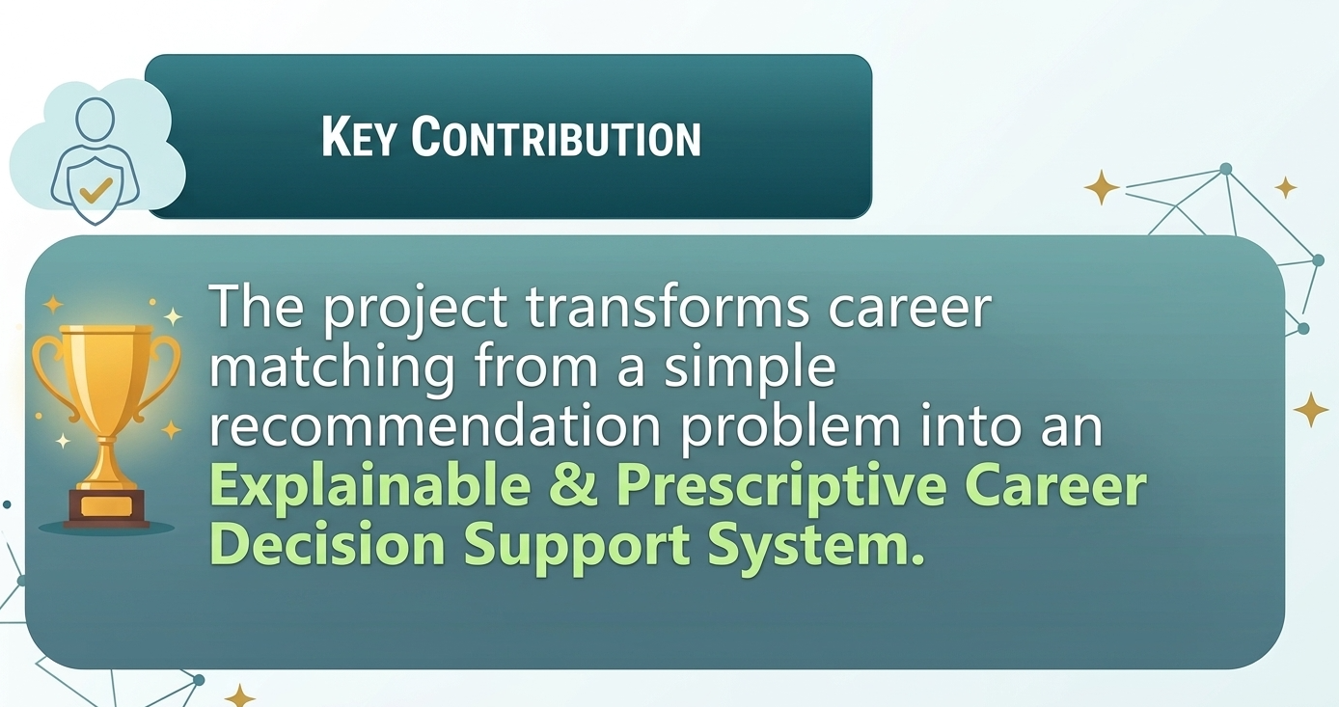
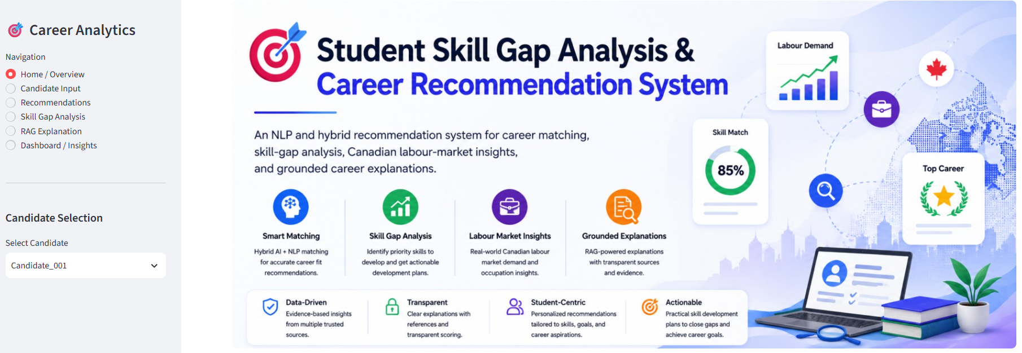
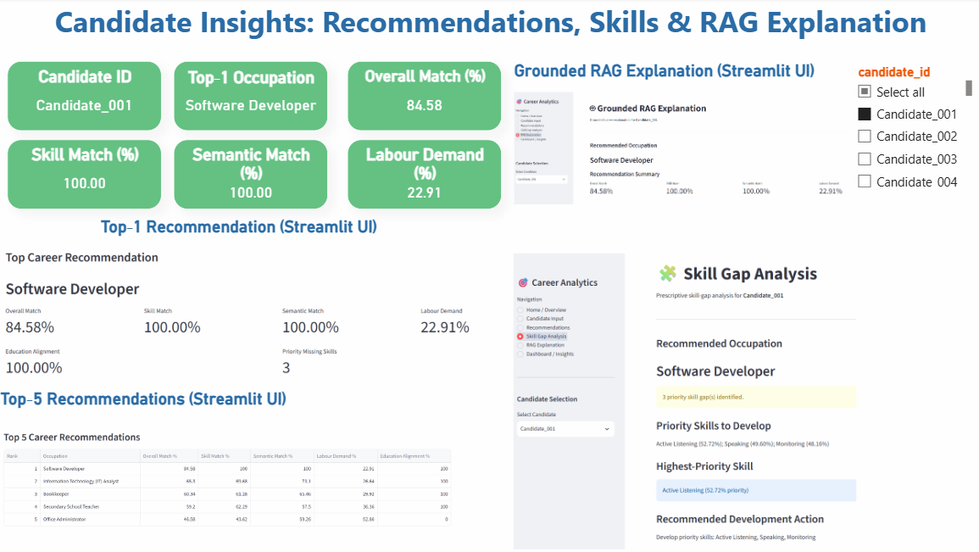
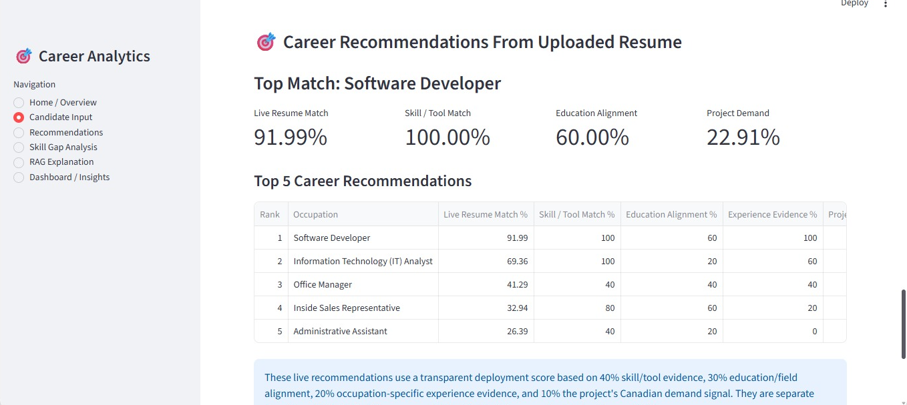

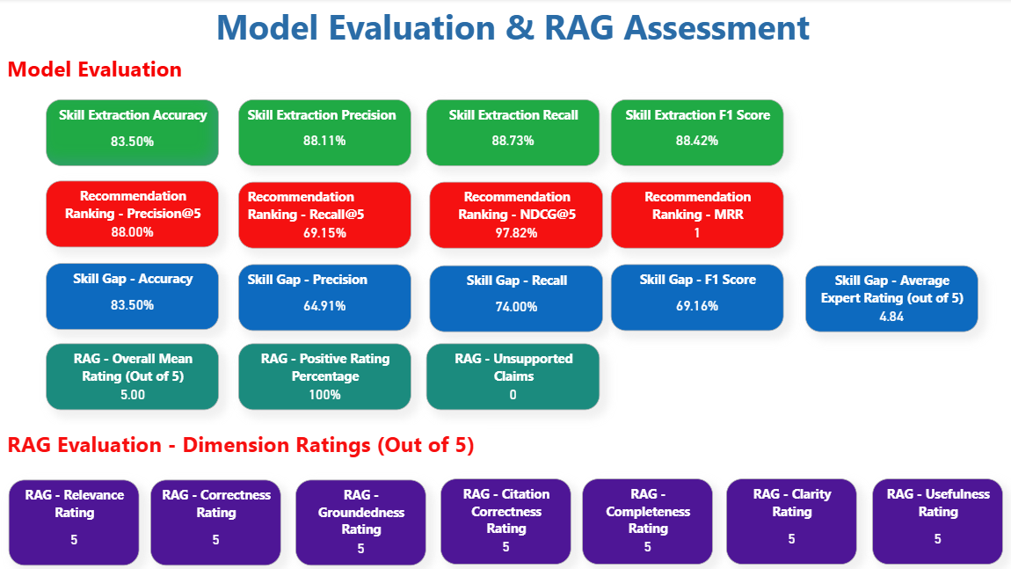
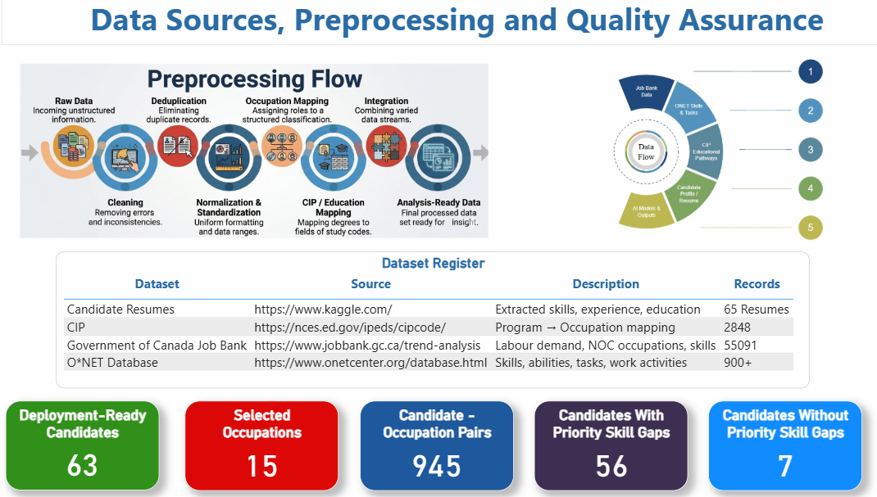
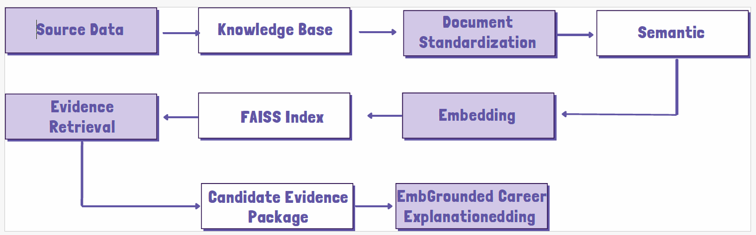

Project Title: AI-Powered Career and Skill-Gap Recommendation System Using Canadian Job Bank Data, O*NET Occupational Information, and CIP Educational Pathways
Course: Capstone Project (DAMO-699-1)
Program: Master of Data Analytics, University of Niagara Falls Canada
Instructor: Mehdi Mostofi
System Architecture
Key Findings & Visualizations
Group Members:
Alveera Malik, Arya Unni, Ansu Joy,
Jasmine Jose and Souren Chowdhury
Project Overview
This project develops an integrated career recommendation and skill-gap analysis system that connects candidate profiles with suitable occupations using NLP, semantic matching, occupational skill requirements, Canadian labour-market demand and educational pathways.
Methodology
Background
Deployment & Analytics Products
Strong alignment - Most candidates show very high skill and semantic match (often 100%), meaning their resumes closely fit the occupations recommended by the model.
Software Developer dominates - Over half of all candidates receive “Software Developer” as their top recommendation, showing strong transferable digital skills across the group.
Labour demand varies - Even when skill match is high, labour‑market demand scores differ widely, meaning some jobs are a great personal fit but not always in high demand.
Top‑5 recommendations diversify - When looking beyond the top‑1 result, candidates match with a broader set of occupations like IT Analyst, Bookkeeper, Office Administrator, and Teacher.
User Interface
Home Page
Research Questions
Primary Research Question
RQ1: How much better can an integrated career recommendation system, using Canadian Job Bank labour-demand data, O*NET occupational information, and CIP educational pathways, improve career and skill-gap recommendations compared to traditional keyword-based matching?
Secondary Research Questions
RQ2: Which selected occupations have the most postings and vacancies in Canada?
RQ3: How does the demand for selected occupations differ across provinces or territories?
RQ4: Which O*NET knowledge areas, skills, and abilities are most important for selected positions?
RQ5: What educational programs are associated with the selected occupations based on the CIP-SOC crosswalk?
RQ6: How accurately can the system identify skills, education, experience, certifications and projects from the resumes of the selected applicants?
Live Result
Scan Me
Data & Data Quality
RAG Architecture
Limitations
Future Research
Example Candidate RAG Evidence Package
Resume/skill extraction errors
NOC–SOC–O*NET mapping limitations
Labour‑market demand changes over time
Relatively small candidate dataset (63 candidates)
Limited labelled data for supervised Machine Learning
Semantic‑model limitations
Expand the candidate dataset to improve generalizability.
Introduce larger labelled outcome datasets to support supervised learning and outcome-based validation.
Improve semantic recommendation models to strengthen contextual matching.
Integrate real‑time labour‑market APIs for continuously updated demand information.
Enhance and scale the deployed Streamlit application for broader practical use.
Evidence Component | Example Output
Candidate | Candidate_001
Recommended occupation | Software Developer
Hybrid score | 84.58%
Priority skill gaps | Active Listening, Monitoring, Speaking
O*NET evidence | RAG document IDs
Task evidence | Occupational task documents
Labour-market evidence | Canadian demand document
Education evidence | CIP pathway document
Strategic Insights
Candidates
Prioritize high‑importance missing skills to improve career readiness.
Universities
Align academic programs with occupational skill requirements.
Employers
Use skill‑gap evidence to identify workforce development needs.
Career Services
Provide personalized occupation and skill‑development pathways.

